Slide 1
Traffic sign detection
Names: EBANCA Stefan
Gabor Raul
Cadar Damian
Kohan Alexandru

Slide 2
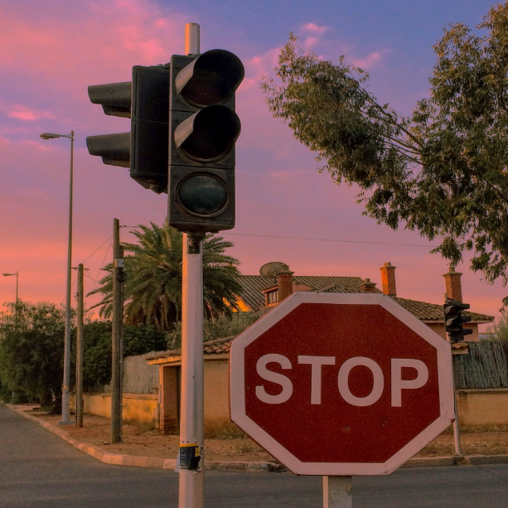
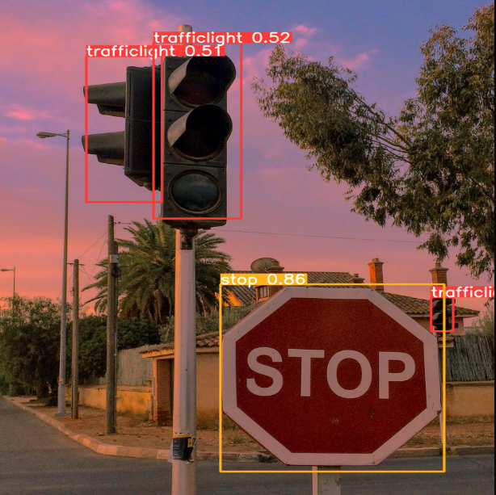
Brief overview of the problem
Ensuring road safety hinges on the effective detection of critical traffic signs, particularly those pertaining to traffic lights, speed limits, crosswalks, and stop signs. Our application prioritizes the accurate identification of these specific signs to address key safety aspects. The detection of traffic lights is fundamental for signaling changes in traffic flow, guiding drivers safely through intersections. Identifying speed limit signs is crucial in promoting adherence to specified speed regulations, contributing to accident prevention and overall road safety.

Slide 3
Brief overview of the problem
The recognition of crosswalks is imperative for both drivers and pedestrians, enhancing safety in areas where foot traffic intersects with vehicular movement. Finally, the identification of stop signs is pivotal in ensuring that drivers come to a complete halt, preventing potential collisions. Leveraging YOLOv5, our app delivers precise and real-time detection for these essential traffic signs, emphasizing their critical role in mitigating accidents and fostering secure driving conditions.

Slide 4
Interacting with the application
Interacting with our traffic sign detection app is designed to be straightforward and user-friendly. Users can follow these steps to effectively utilize the application:
Begin by selecting the "Image Upload" button on the user interface.
Select the desired image file containing the traffic signs of interest and click "Open."
Once the image is uploaded, the app will initiate the processing of the image using YOLOv5, our object detection model.
The app will display the original image alongside the detected traffic signs. Each identified sign will be highlighted for easy recognition.
Users can analyze the results to interpret the detected traffic signs. The app specifically focuses on four sign categories: traffic lights, speed limits, crosswalks, and stop signs.

Slide 5


Slide 6
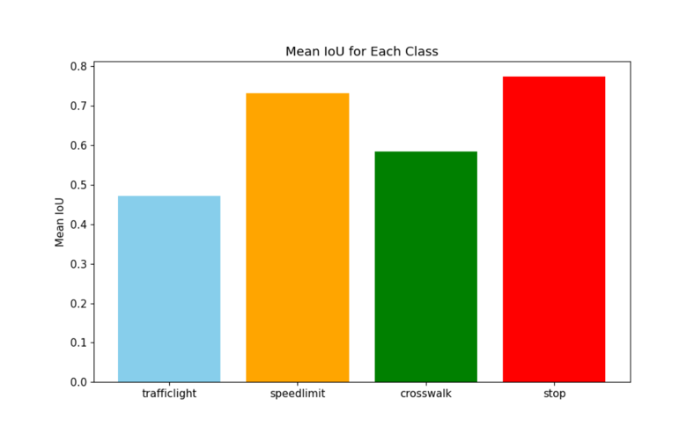
TECHNOLOGIES USED THROUGHOUT THE APPLICATION
Our traffic sign detection app integrates two core technologies: Flask for the backend and React for the frontend. The backend, powered by Flask, efficiently handles user requests and utilizes the YOLOv5 model for real-time object detection.
On the frontend, React provides a responsive and interactive user interface, enabling users to seamlessly upload images.
The communication between the frontend and backend is facilitated by the Fetch API. Together, these technologies create a robust and user-friendly application, enhancing road safety through accurate and real-time detection of critical traffic signs.
We built and trained the model ourselves using a dataset of 800 pictures of various traffic signs in different environments using YOLOv5.
Out of all the traffic signs the stop sign seems to be detected the best followed by the speed limit
Traffic light seems to be detected the worst having 0.48 accuracy

Slide 7
FUTURE PLANS
Continuously optimize the underlying YOLOv5 model for improved accuracy and efficiency, potentially exploring newer iterations or advancements in object detection technology.
Explore the possibility of integrating the app with popular navigation systems to provide real-time alerts and guidance based on detected traffic signs, contributing to a more dynamic driving experience.
Introduce multilingual support for recognizing and interpreting traffic signs in various languages, making the app more accessible to a global user base.

Slide 8
Conclusions
We tried using Tiny YOLO but the training seemed to be complicated and inaccurate.
We tried different epochs, batch sizes, image sizes until we found the sweet spot for the model.
The integration of the model in the backend was challenging because of the installation of dependencies.
The deployment of the application was relatively fast.

